Slide 1

DE Mini Project
DSLS 2023 - Data Consultant
Sharon Regina (Group 7)
sharonregina99@gmail.com

Slide 2
Product Analysis
Objective: Analyse the discontinued products’ potential; who to sell it to and potential revenue we can get.
Data: a.productid, a.productname, a.unitsinstock, a.discontinued,
b.orderid, b.unitprice, b.quantity, b.discount,
c.customerid,
d.companyname, d.contactname, d.phone
Tables: products, order details, orders, customers

Slide 3
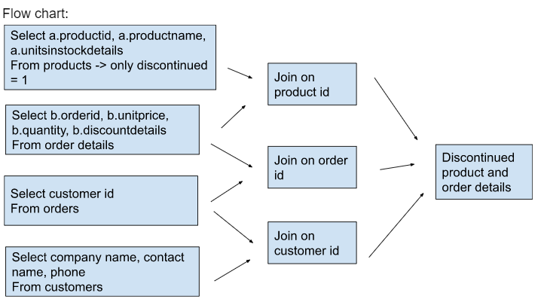
Product Analysis

Slide 4
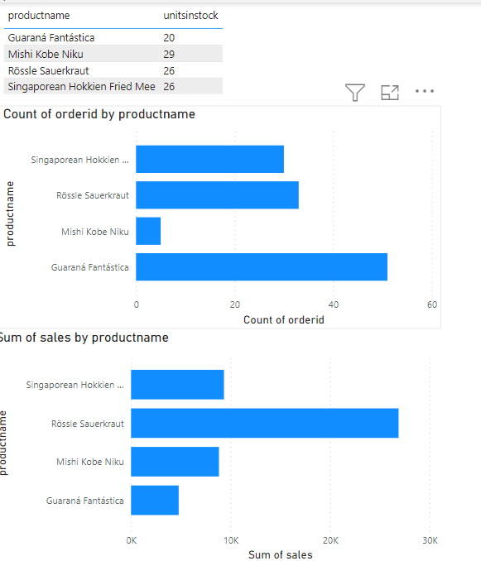
Product Analysis
There are discontinued products with stocks > 0.
Discontinued products can cause loss for Northwind, thus, we need to know the potential customers to sell these stocks to.
The most potential customers are those who have bought the same products in the past.

Slide 5
Product Analysis
Historically, among the discontinued products, the Mishi Kobe Niku has the least order, thus it might need higher discount rate than others to be sold off, especially since it’s also quite pricey compared to other products.

Slide 6
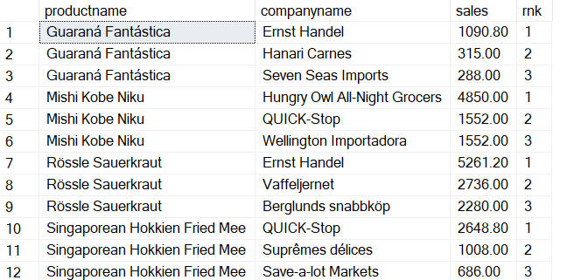
Product Analysis - Recommendation
Northwind can offer these discontinued products to companies with the highest sales per product since they’re the most likely to buy.
This way, Northwind can gain revenue from these sales.

Slide 7
Customer Analysis
Customer Analysis
Objective: Analyse who our top customers are over 3 years for loyalty programs.
Data: b.orderid, b.unitprice*b.quantity sales,
c.customerid, cast(c.orderdate as date) orderdate, year(cast(c.orderdate as date)) orderyear,
d.companyname, d.city, d.country
Tables: order details, orders, customers

Slide 8
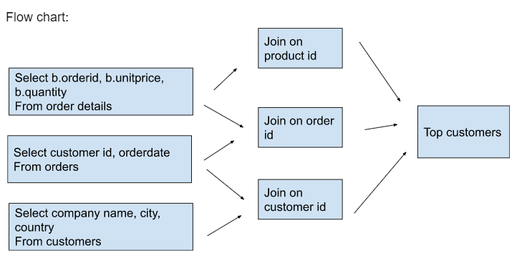
Customer Analysis

Slide 9
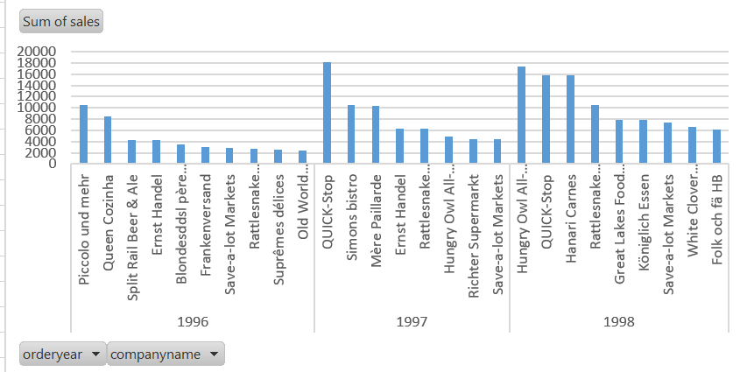
Customer Analysis
Throughout 1996 - 1998, Northwind’s top 10 customers have increasing sales but only two customers consistently stay in the top 10 list, who are Save-a-lot-Markets and Rattlesnake, meaning that there is still room for improvement.

Slide 10
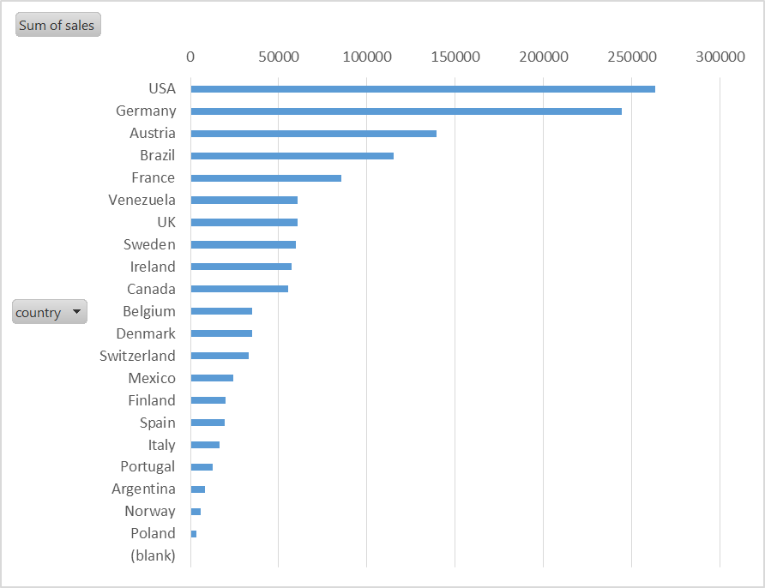
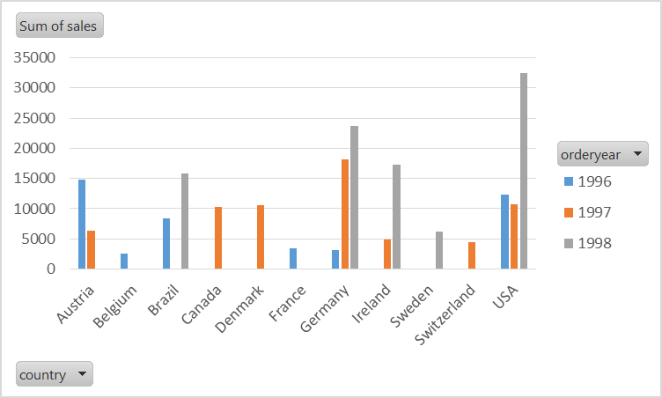
Customer Analysis
Looking at the customer demographics for the top sales, USA, Germany and Austria contributes most of Northwind’s sales, but Austria doesn’t contribute to any orders in 1998. Instead, Brazil and Ireland seems to be Northwind’s focus in 1998.

Slide 11
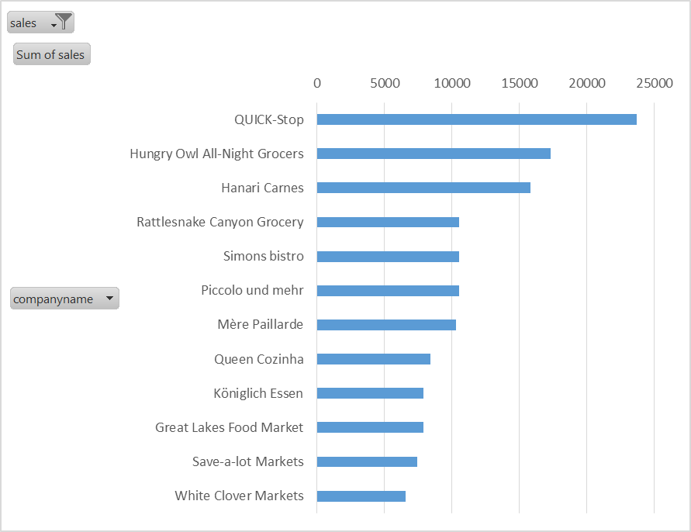
Customer Analysis - Recommendation
Since having a loyal customer base is important, Northwind is suggested to have a relationship manager or a loyalty program for their top customers with biggest sales throughout the 3 years.
Northwind also can expand operations in countries like Ireland and Brazil.

Slide 12
Employee Analysis
Objective: Analyse who our top employees are.
Data: b.employeeid,
count(distinct b.orderid) count_order, concat(c.firstname,c.lastname) fullname,
title,year(HireDate) - year(birthdate) as hired_age,
city,country
Tables: orders, employees

Slide 13
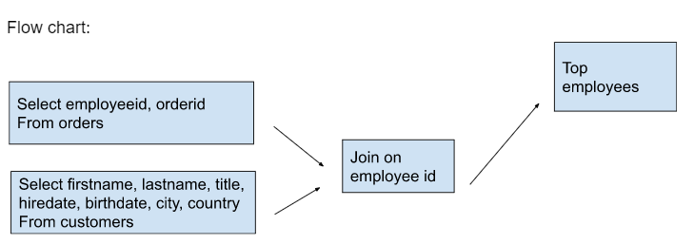
Employee Analysis

Slide 14
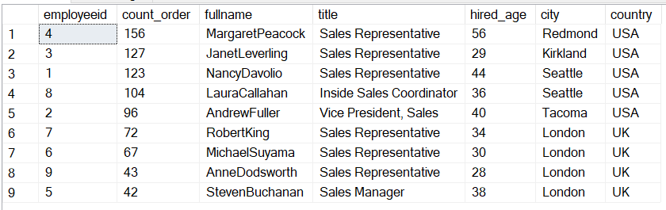
Employee Analysis
There are 9 employees in Northwind with 6 Sales Representatives and most of them come from USA and UK.
Among all the employees, Margaret Peacock has the most orders.
Ironically, the Sales Manager has the least amount of sales.
Anne Dodsworth and Michael Suyama performed rather poorly compared to the top 3 performers.

Slide 15
Employee Analysis - Recommendation
The uneven distribution of the number of orders by each employees can mean that Northwind needs to train poor employees more or do employee appraisal.
Top employees need to be rewarded for them to keep up the good work.

